Slide 1
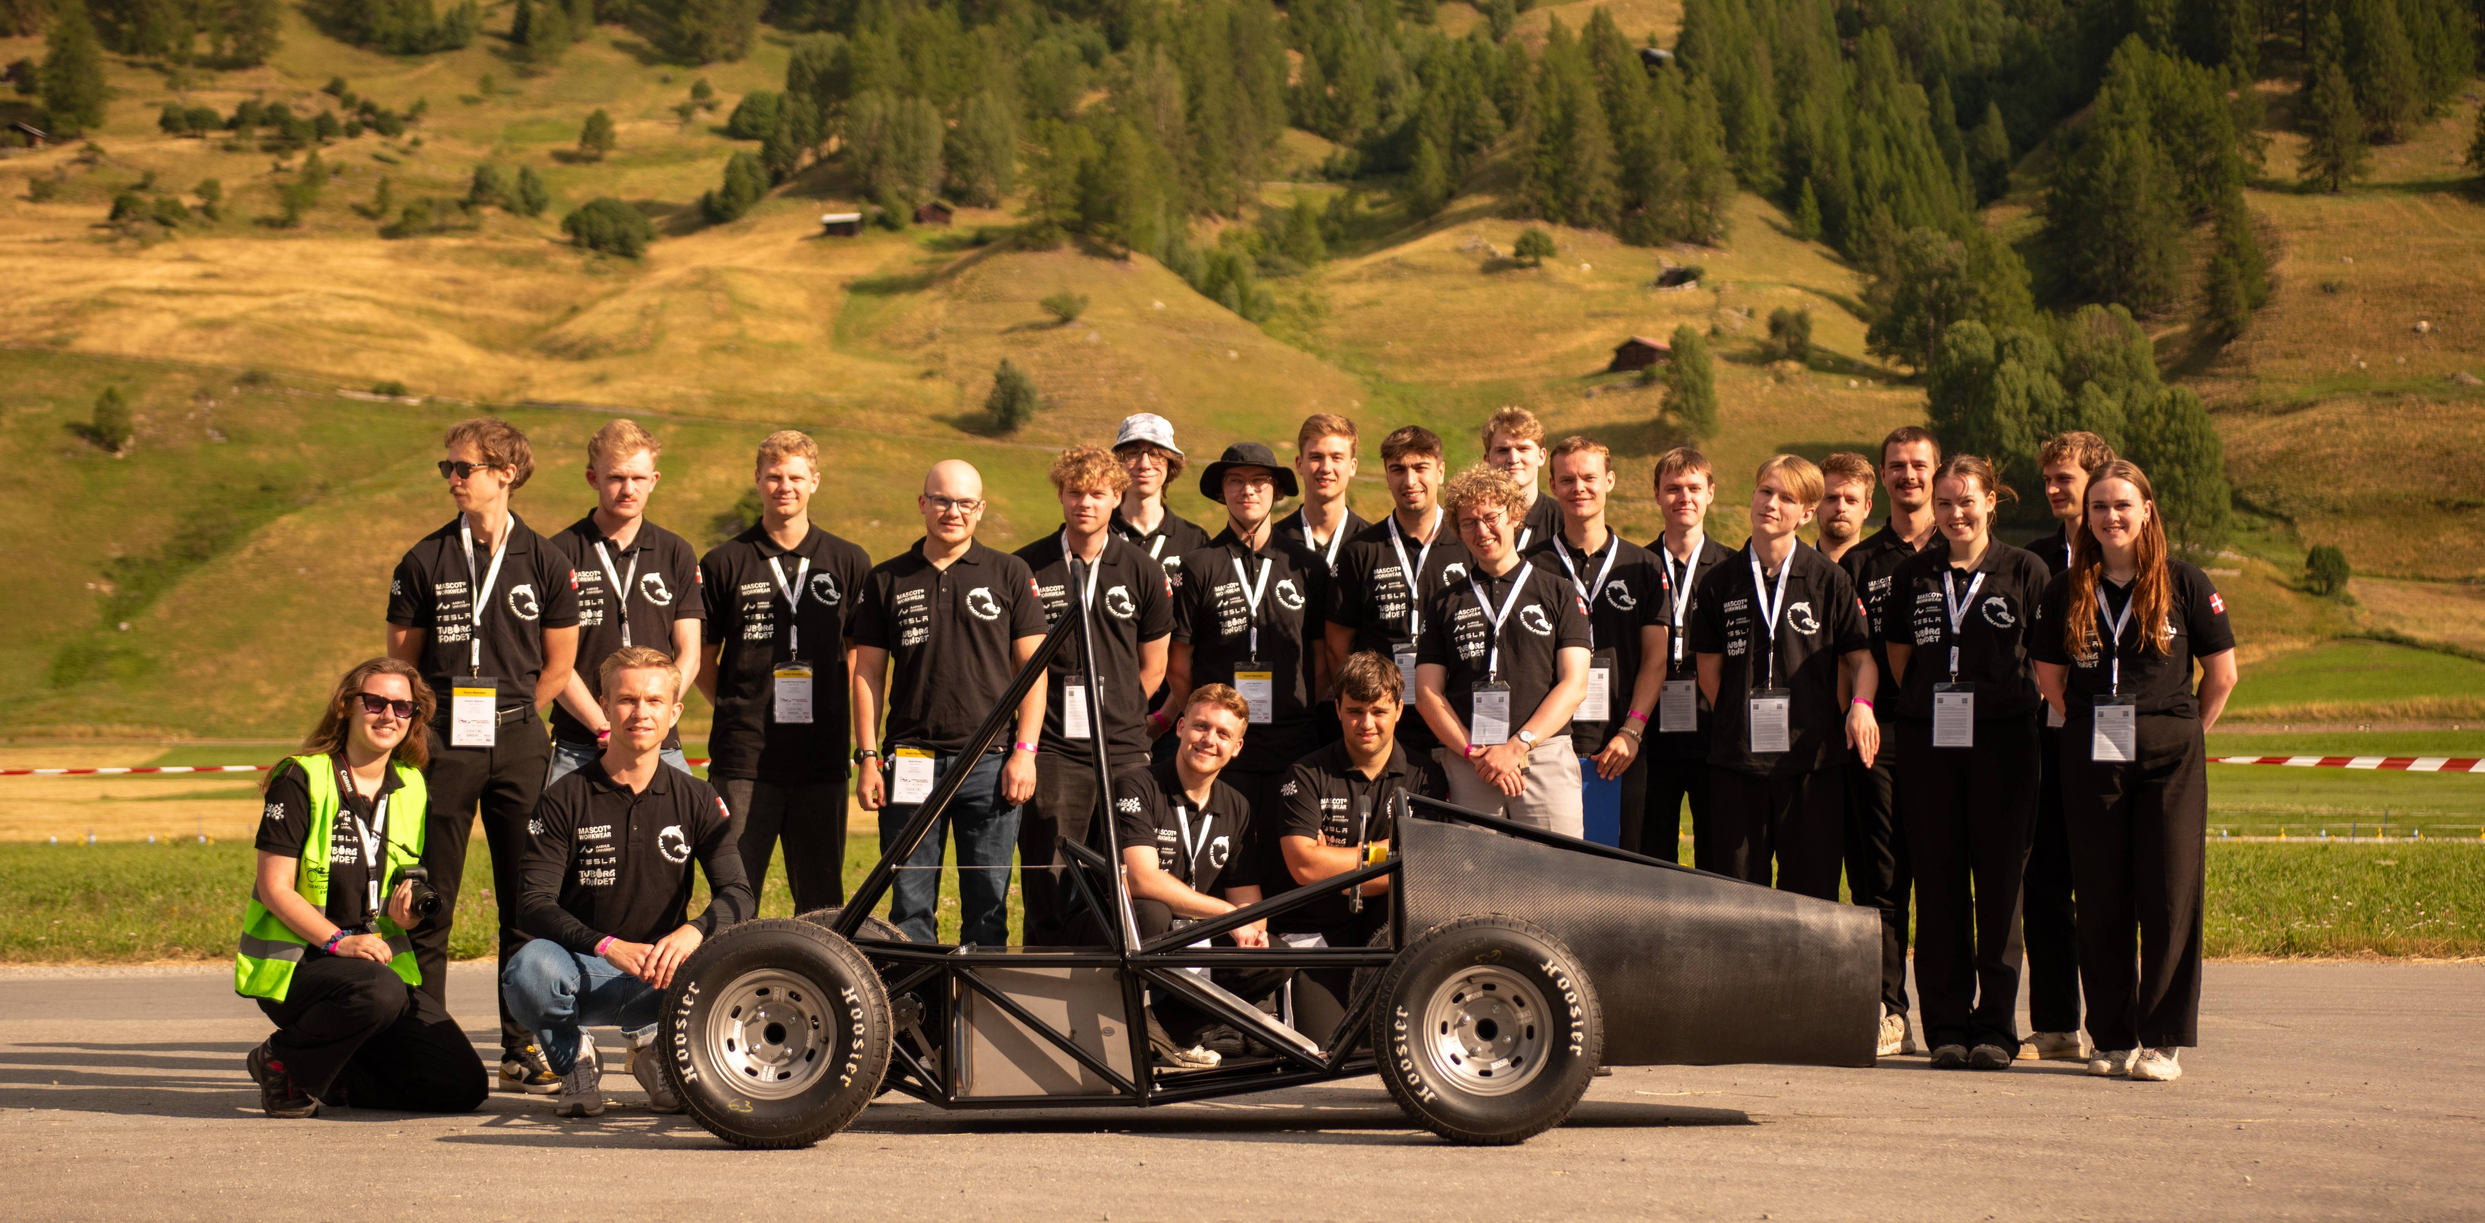
Introduction of AU Dolphins Racing Team
Design, build, race – join the team!
24-09-2025

Slide 2
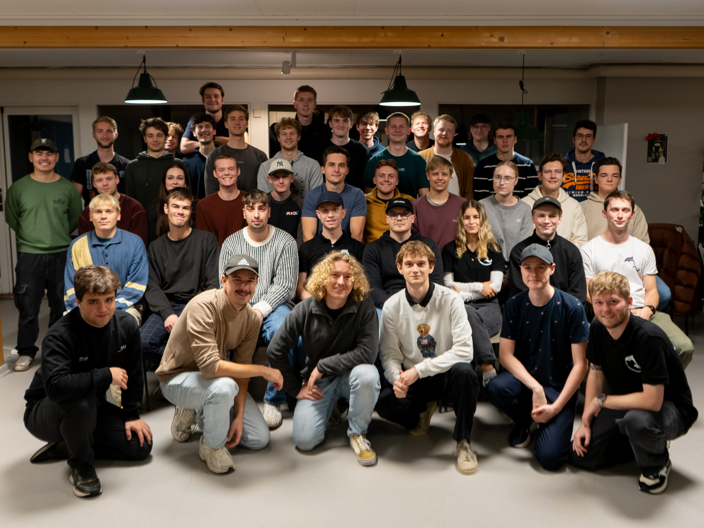
The team
Founded 10.03.2023
Student Association – made by students for students
38 members
Team Lead
Line Anine Boi
Email: teamcaptain@audolphins.dk

Slide 3
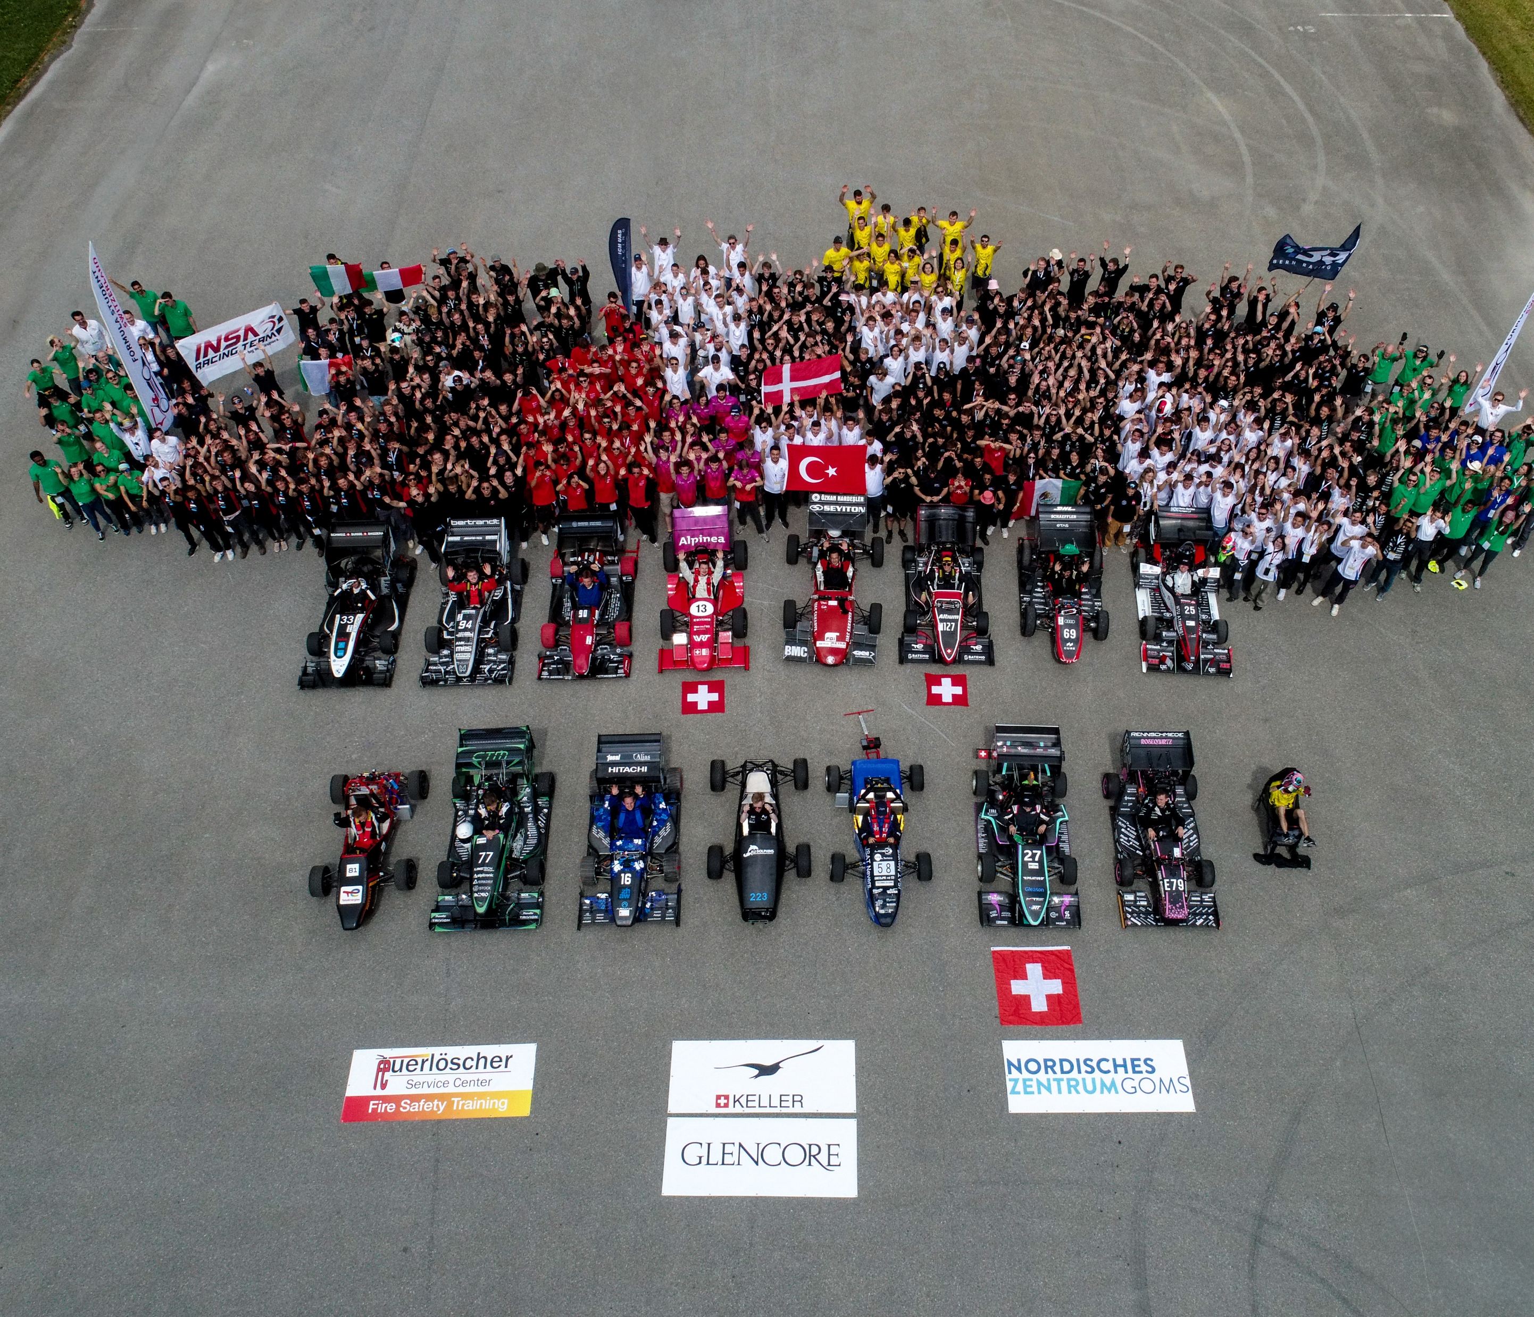
What is Formula student?
International engineering competition for students
Design, build and race a single-seater formula car
Compete against other universities
We participated in the Concept class, where you only compete in the statics events (because our car doesn't drive yet)

Slide 4

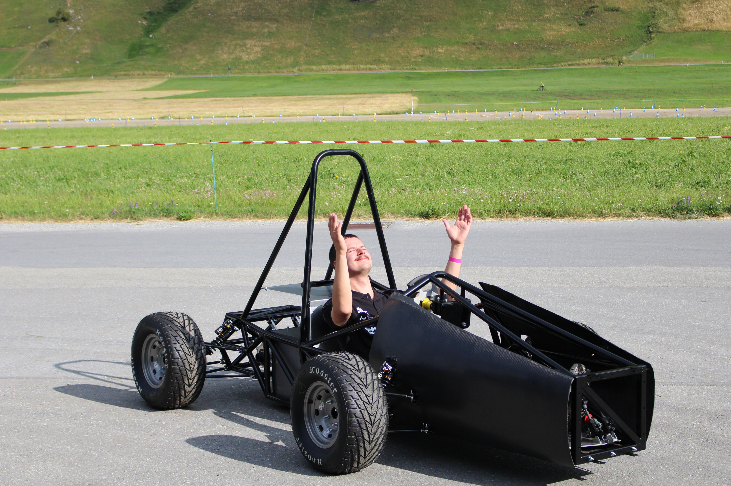
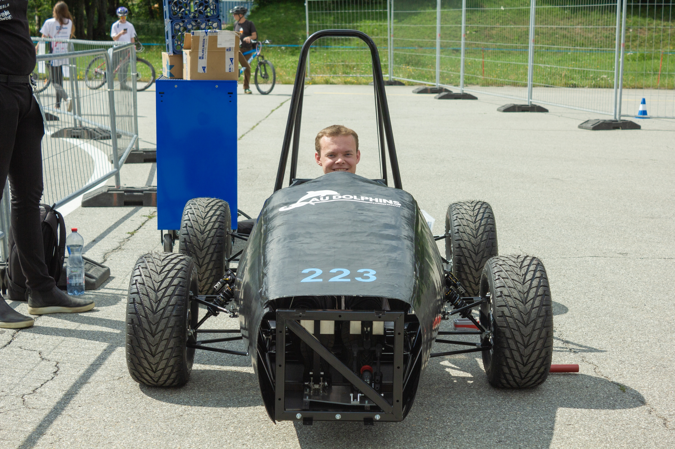
Our Achievement // Next year
3rd Place Concept Class!
2nd Place Engineering Design Event
OUR CAR
Next year? A driving car

Slide 5
What is Formula Student?
Video from this years competition:
https://www.youtube.com/watch?v=K3P9OtrYrK8

Slide 6
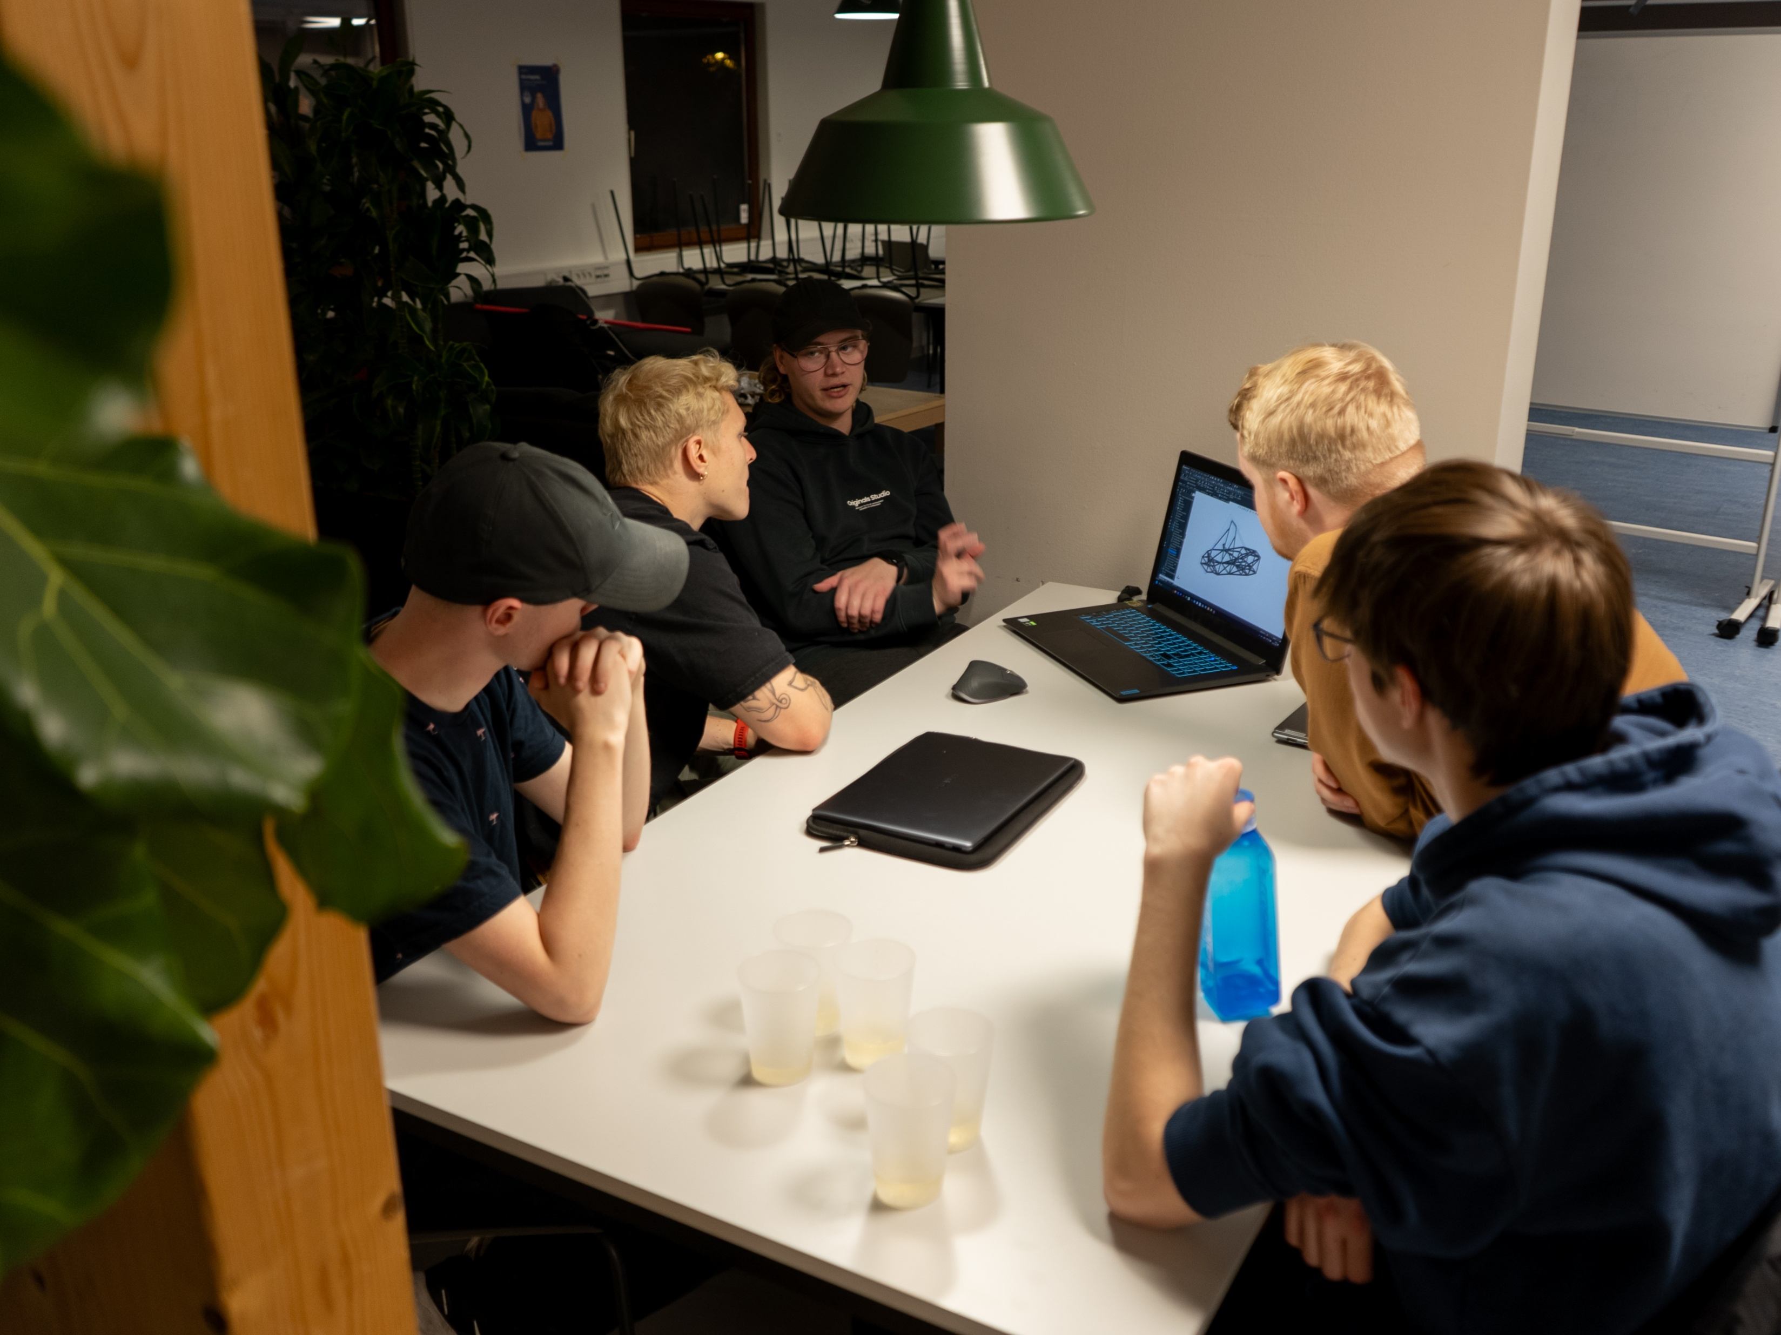
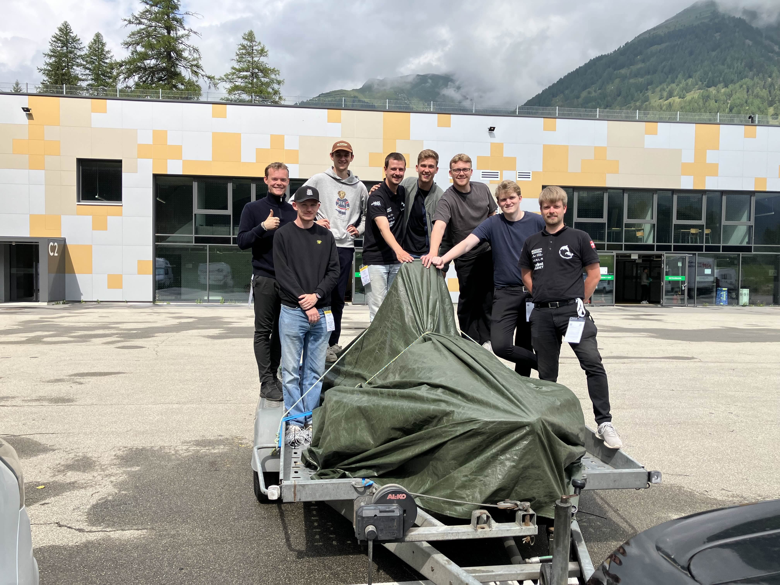
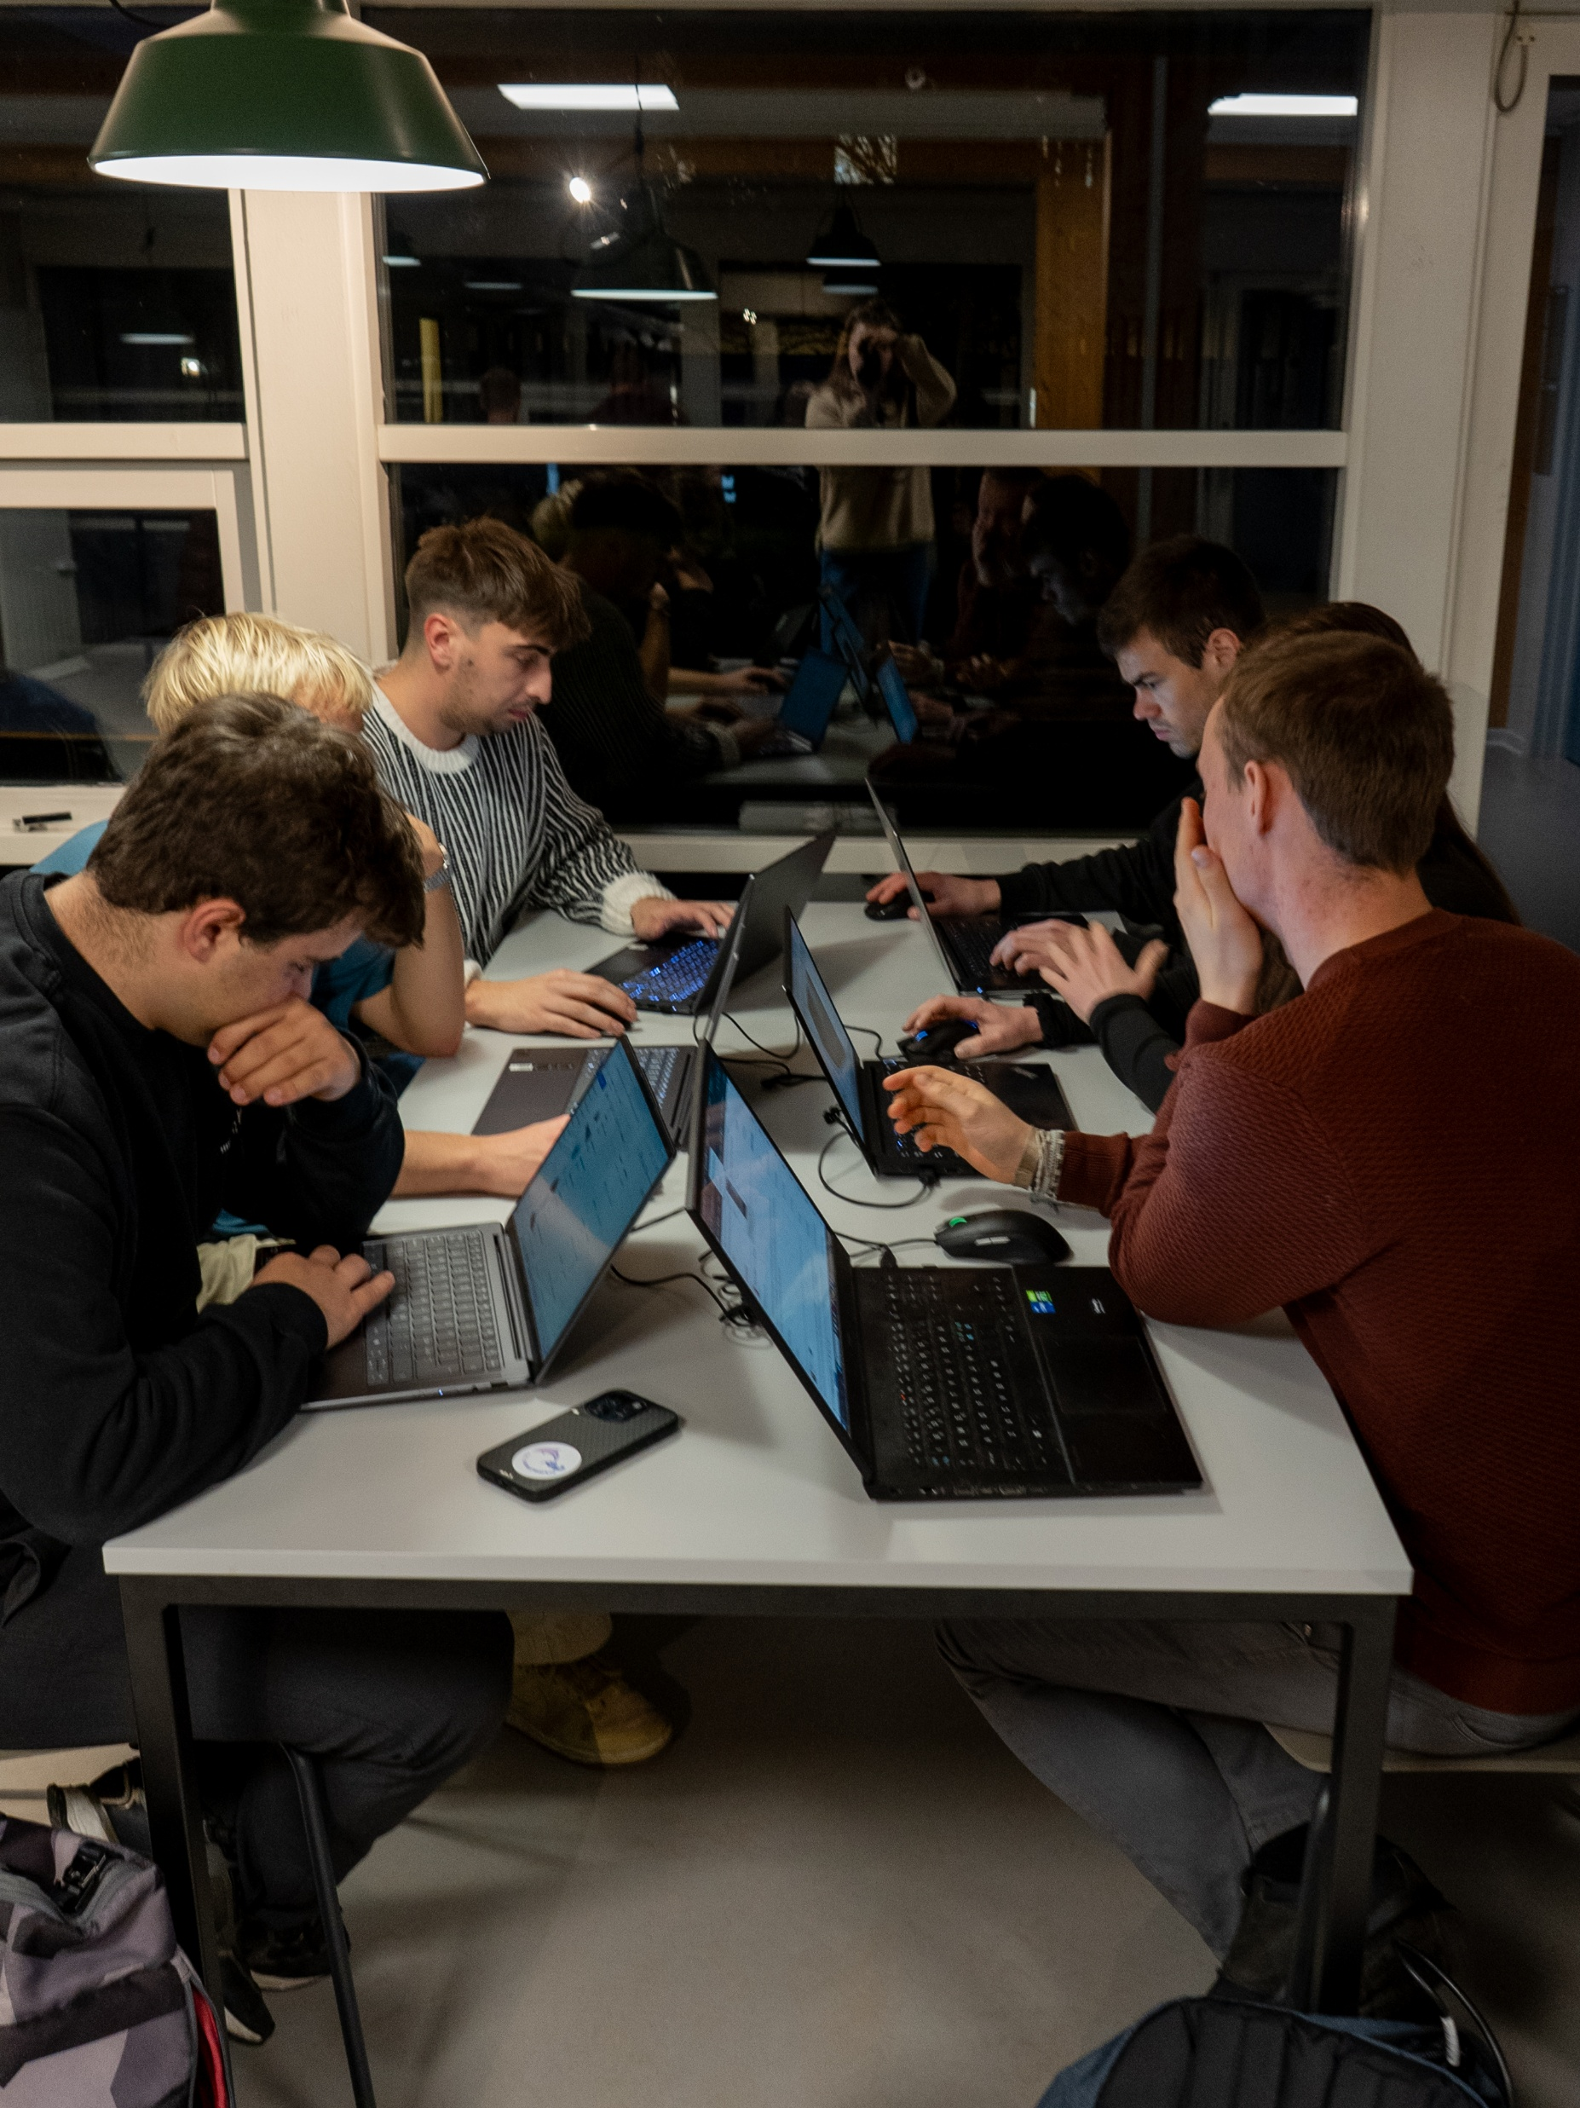
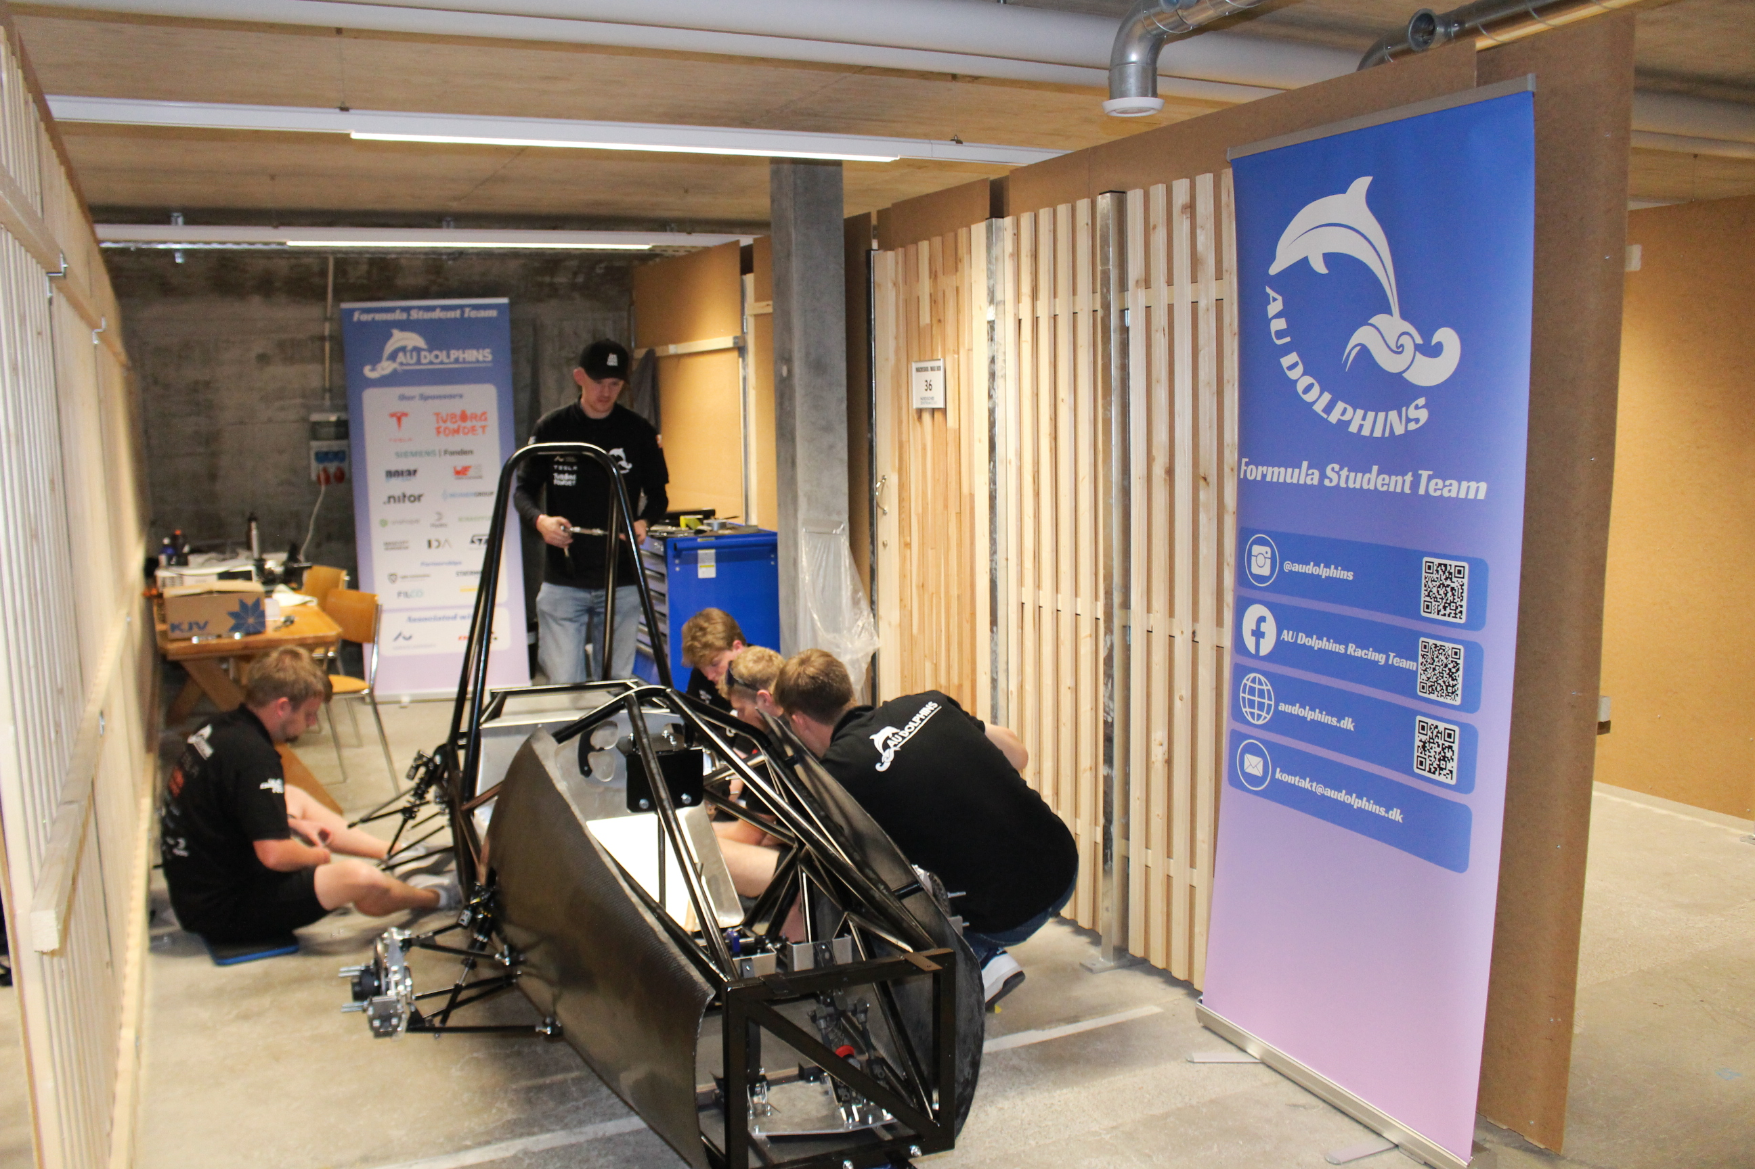
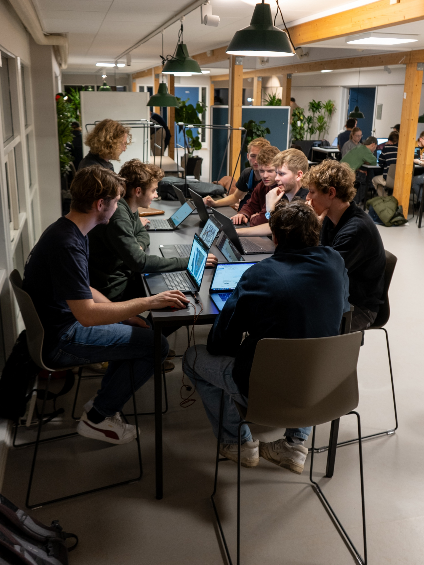
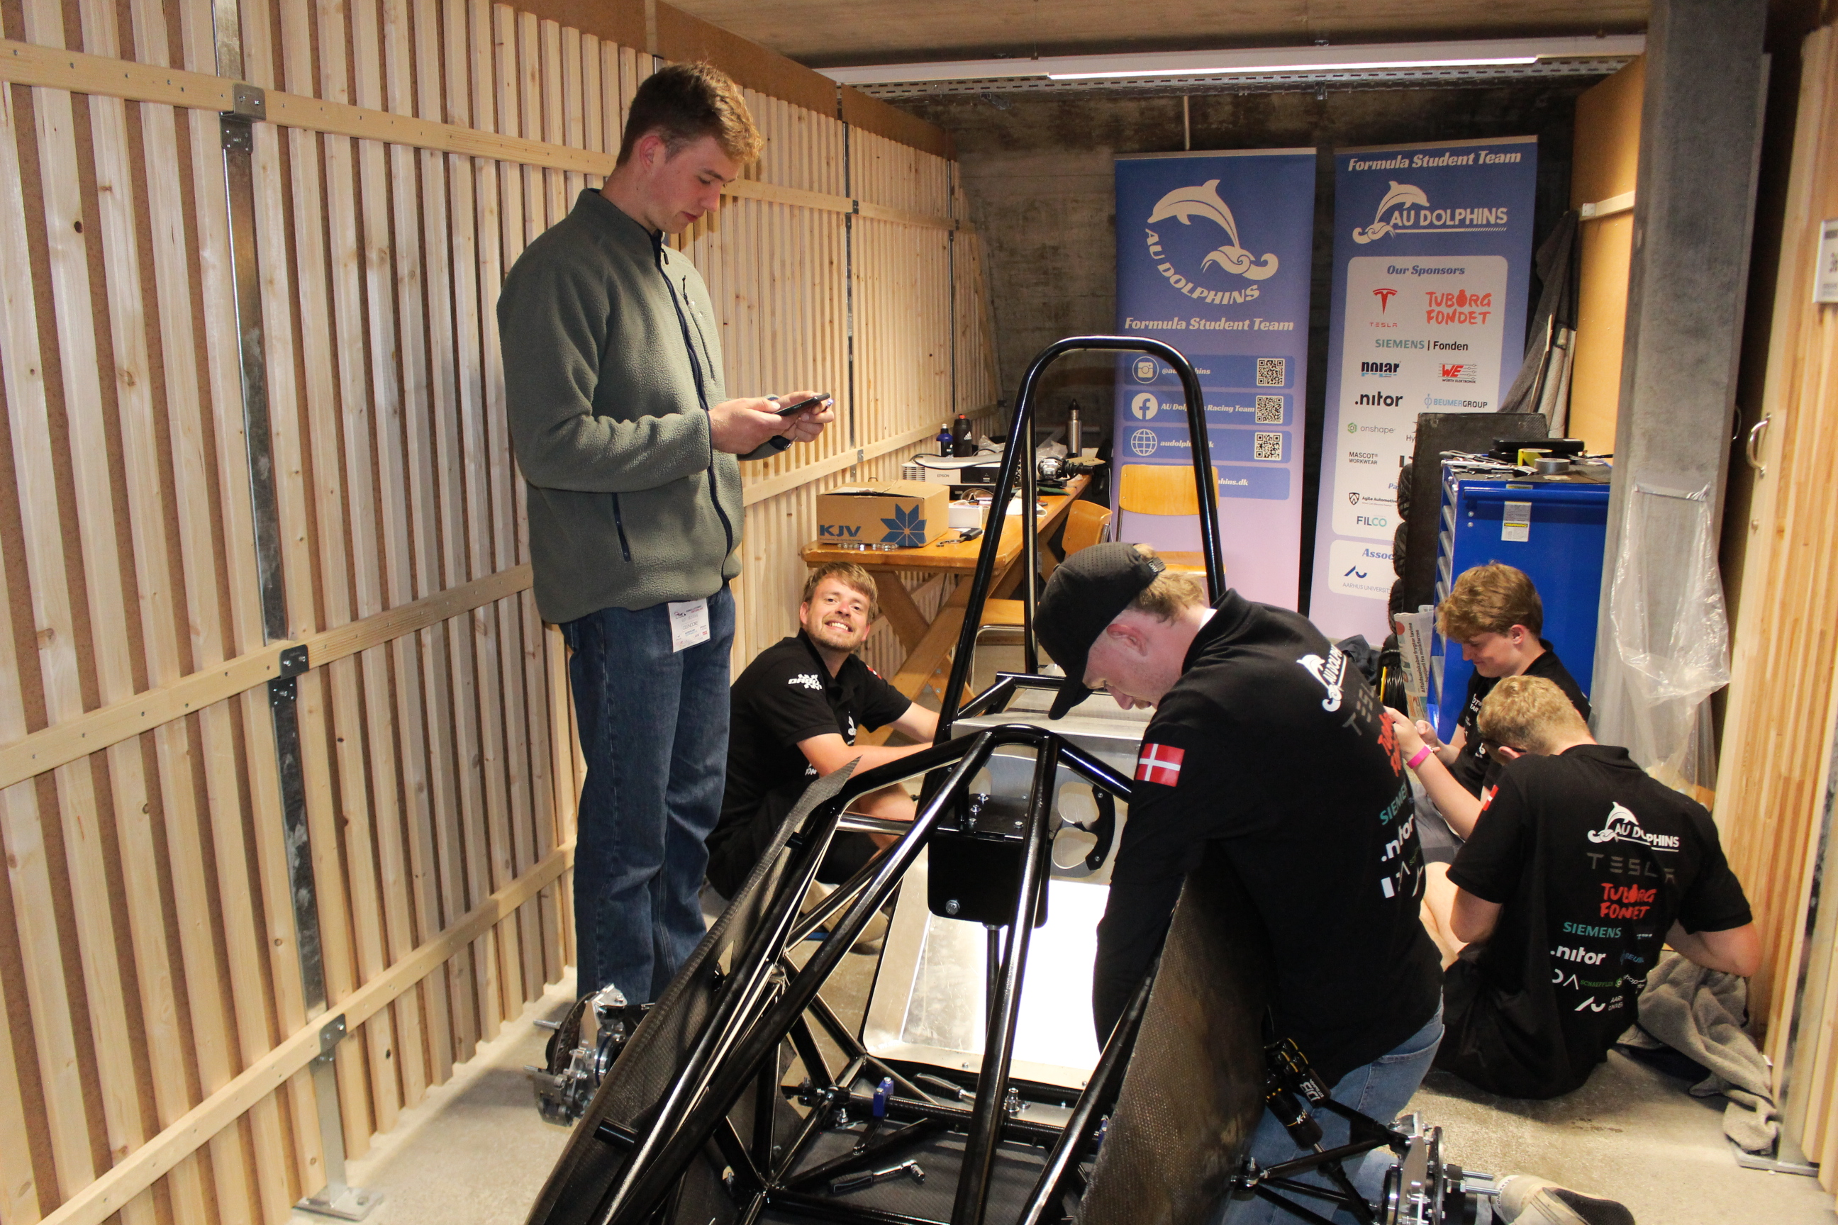
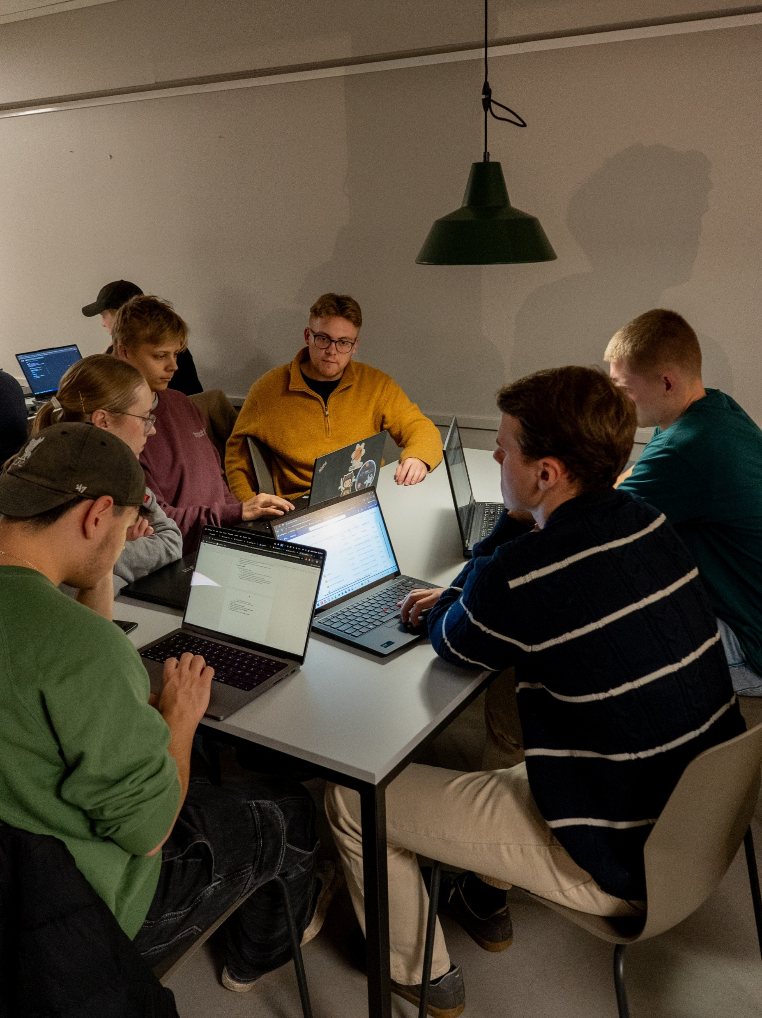
What do we do?
Meet every Wednesday + new added voluntary workday
Workweekends
Work in different departments
Calculate, draw, documentation
Manufacturering
Preparing for quizzes

Slide 7
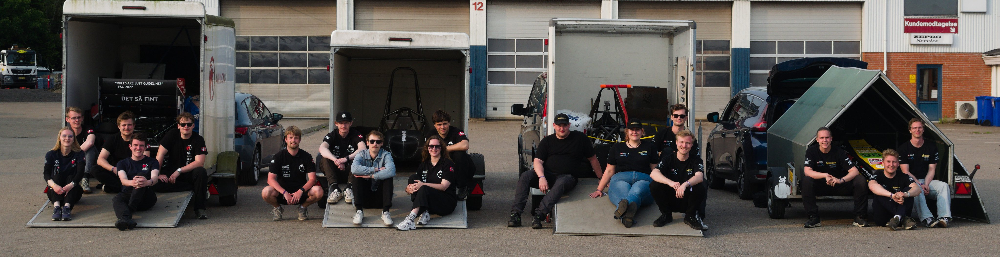




















What do we also do?
Meeting potential sponsors
Writing emails
Get rejections
Hopefully getting money
SoMe
Newsletters
Other materials
Events
D-day
Fairs (Herning Motorshow, Viborg Classic Race, CHGP)
P-day, fridaybars

Slide 8
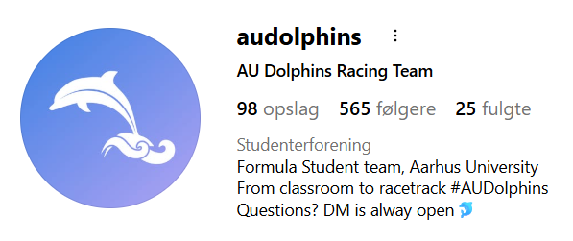
What are we looking for?
New members:
Motivated students
Engineering, design, marketing, business
Willingness to learn
Team players
Application Form: https://forms.gle/799ThZ32oTPttqu36
Potential new sponsor or other inquries?
Find us on Instagram
Get in contact with team lead, Line:
teamcaptain@audolphins.dk
+45 22 11 40 45
Website: www.audolphins.dk

